Slide 1

Credit Risk Modeling for Low-Key Finance
Automating Credit Risk Assessment Using Machine Learning
Nafiul araf | 12/12/2024

Slide 2
Introduction
Problem Statement:
Automate credit risk assessment to improve loan decision-making and reduce default risks.
Objective:
Build a predictive model to classify borrowers based on default risk, ensuring high accuracy and business alignment.

Slide 3
Methodology
Approach:
Data Preparation: Cleaning and handling imbalanced data.
Feature Engineering: Domain-specific and statistical analysis (Weight of Evidence and Information value).
Model Selection: Evaluated Logistic Regression, Random Forest, and XGBoost (final choice).
Evaluation Metrics: AUC, Gini Coefficient, and KS Statistic.

Slide 4
Challenges Faced
Barriers:
Imbalanced dataset (only 10% defaults).
Data quality issues like missing values and outliers.
Computational cost for hyperparameter tuning.
Solutions:
Used SMOTE for over-sampling and under-sampling techniques.
Applied robust preprocessing pipelines and Optuna for efficient tuning.

Slide 5
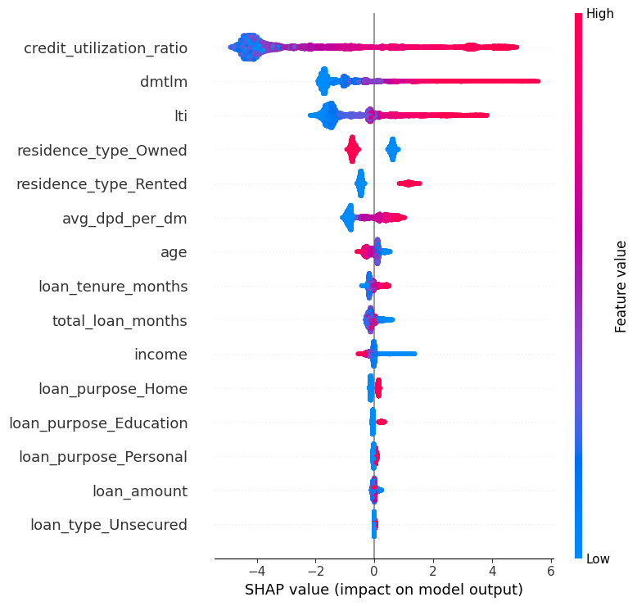
Key Findings and Insights
Insights:
Top predictors: Credit Utilization Ratio, Loan to Income Ratio, and Delinquency Months to Loan Months Ratio.

Slide 6
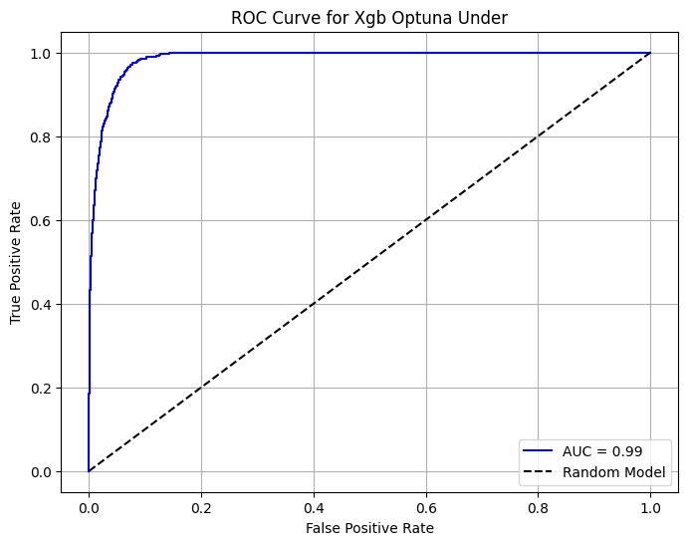
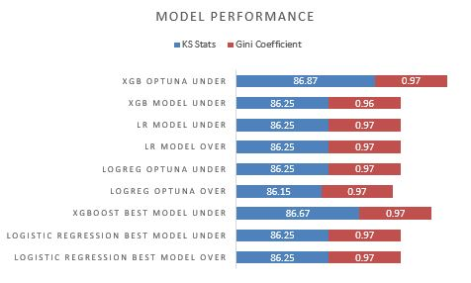
Key Findings and Insights (Cont.)
Insights:
Achieved exceptional performance with XGBoost Model Under-sampling method using Optuna for parameter tuning (AUC: 0.99, Gini: 0.97, KS: 86.87).
Decile analysis confirmed effective separation of high-risk borrowers.

Slide 7
Recommendations and Next Steps
Actionable Suggestions:
Integrate the model into the loan approval workflow.
Use insights to refine credit policies and risk mitigation strategies.
Future Steps:
Retrain the model periodically to address data drift.
Explore additional features like macroeconomic indicators.

Slide 8
Conclusion
Summary:
Developed a robust, interpretable credit risk model with high predictive accuracy.
Provides actionable insights for improving decision-making and managing defaults.
Call to Action:
Ready for deployment and integration into business processes.

Slide 9
Q&A
Questions & Discussion
We welcome your feedback and queries!

